Slide 2
the average person uses 20 BATTERIES each year

Slide 3
In 2015: Canadians bought 700,000,000 batteries

Slide 4
end to end…
Distance around the Earth:
40,000 km
Start
End
700,000,000 batteries
placed end to end:
31,500 km

Slide 5
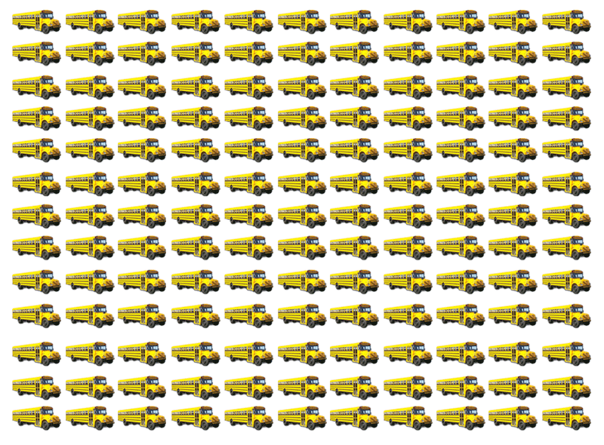
The same weight as
144 buses Every Month!

Slide 6
What does RECYCLING mean to you?

Slide 7
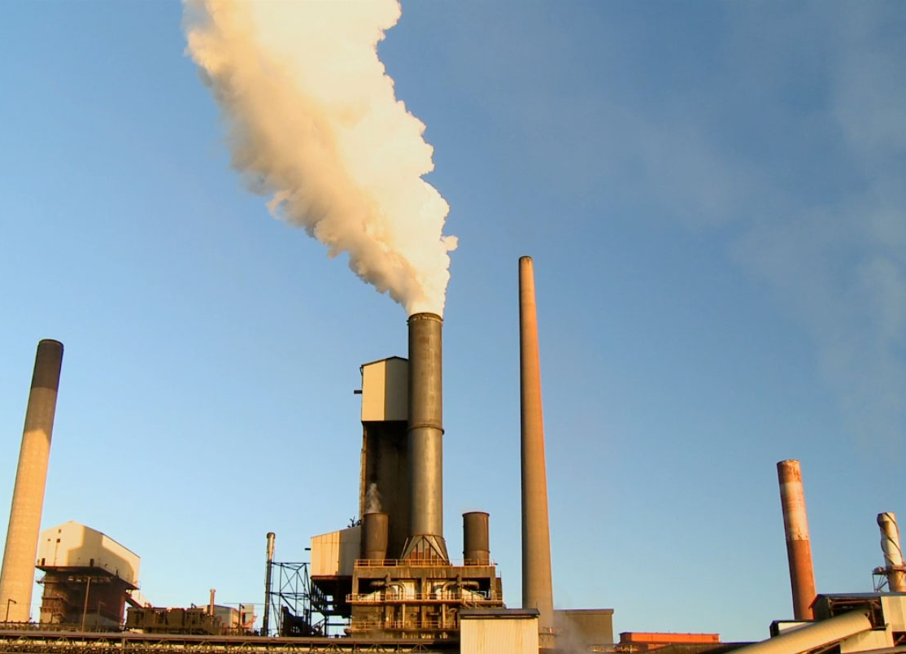
pyrometallurgical

Slide 8
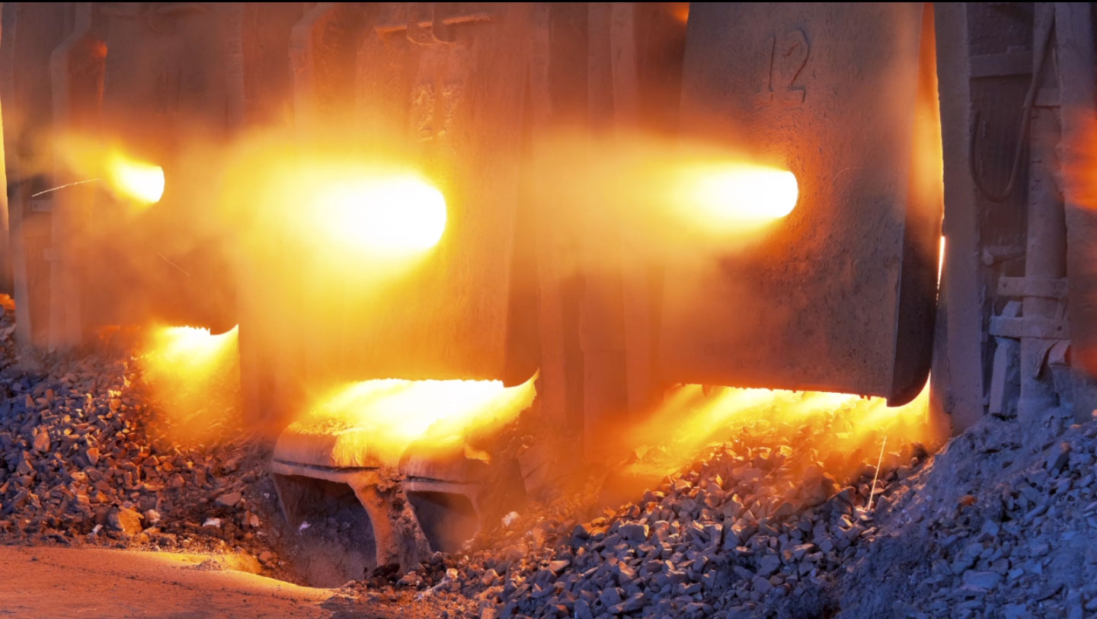

Slide 9
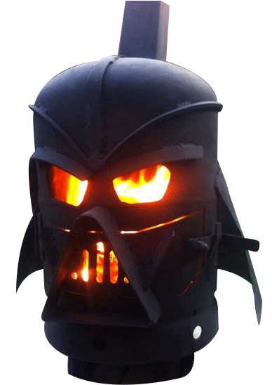
1000 kg in
1 t
440 kg out

Slide 10
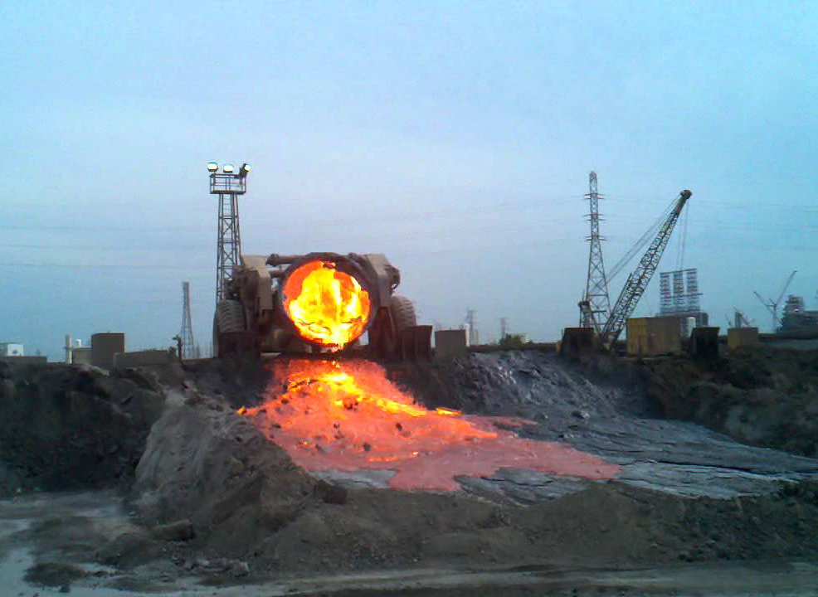

Slide 11
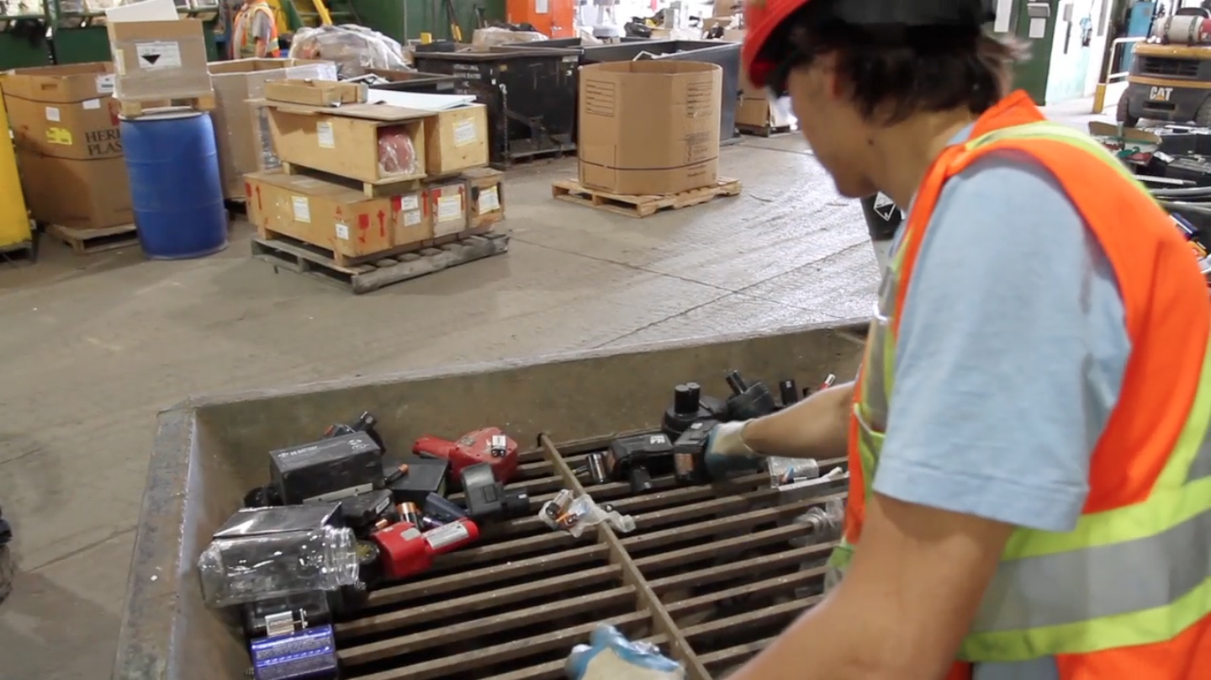
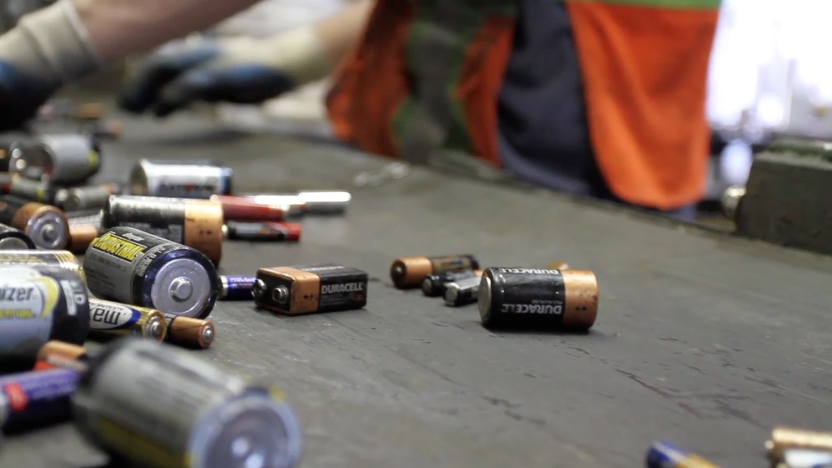
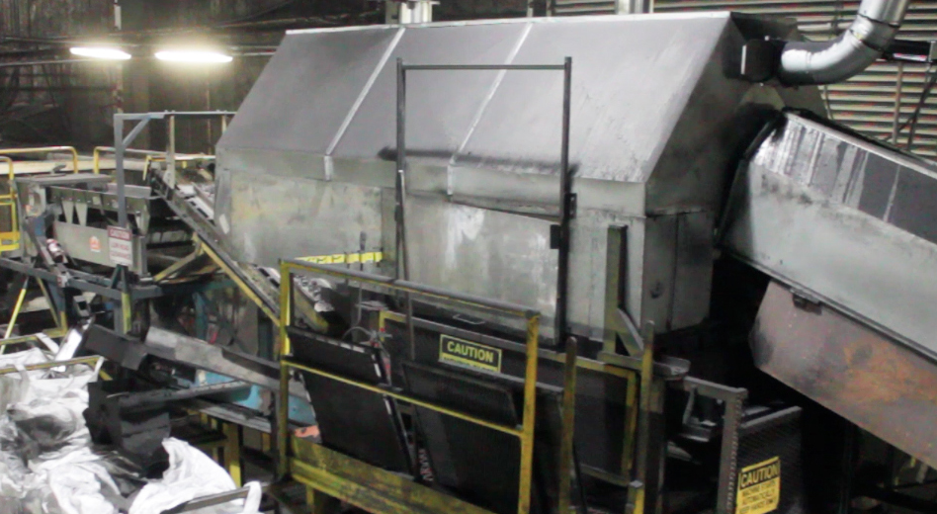
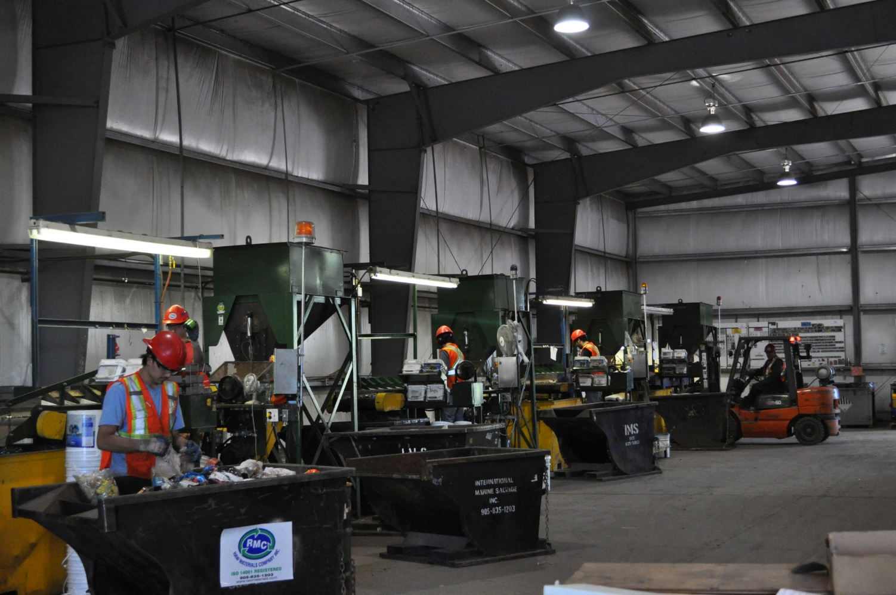
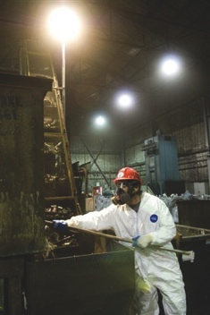
Mechanical

Slide 12
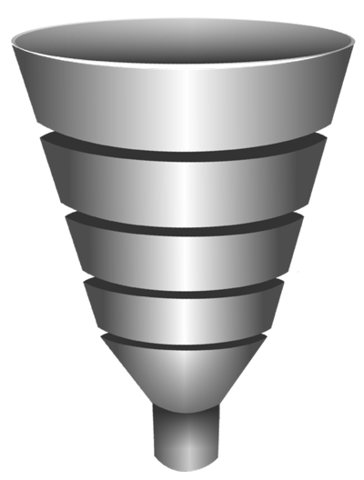
1000 kg in
1 t
1 t
1000 kg out

Slide 13
If all of North America RECYCLED
WE WOULD CONSERVE
184,000 Mwh OF ENERGY
WE WOULD SAVE 41,100 t
OF GHG EMISSIONS
like we do
WE WOULD ELIMINATE
16,300 t OF SOLID WASTE

Slide 16
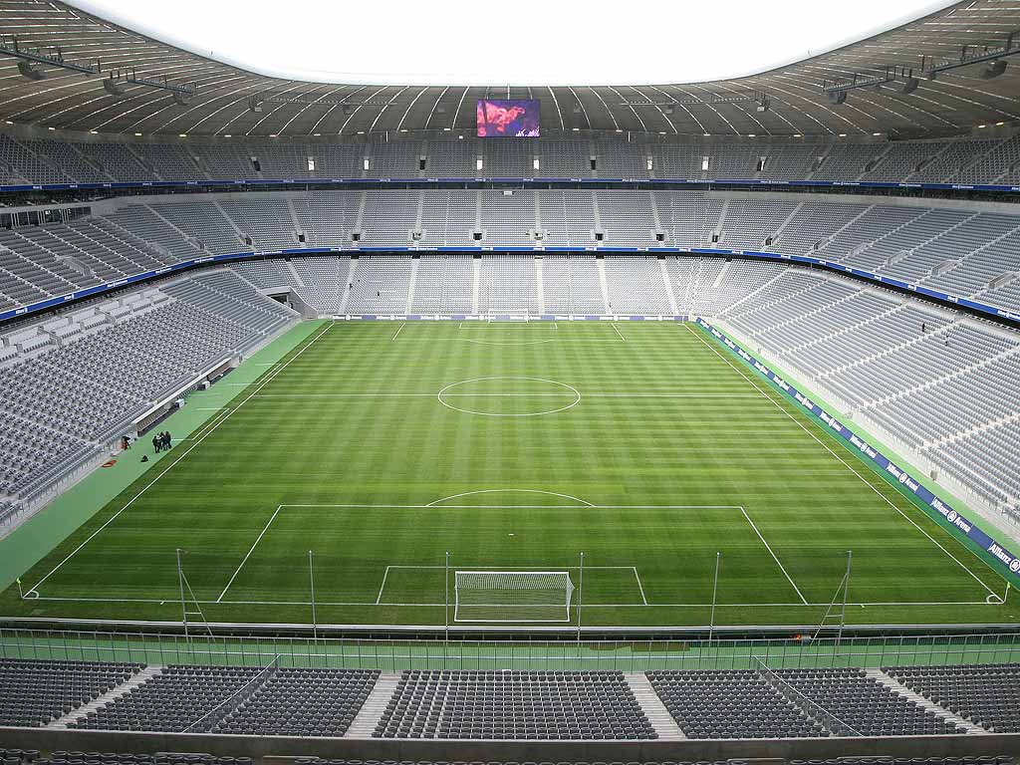
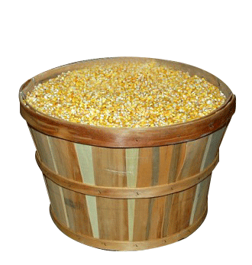
1 Acre = 4046 m²
20 bushels = 508 kilos

Slide 18
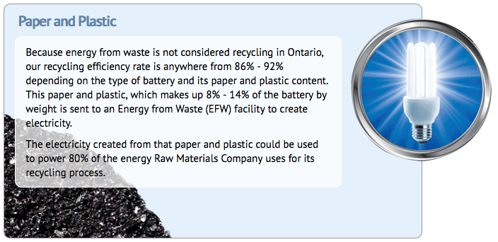

Slide 19
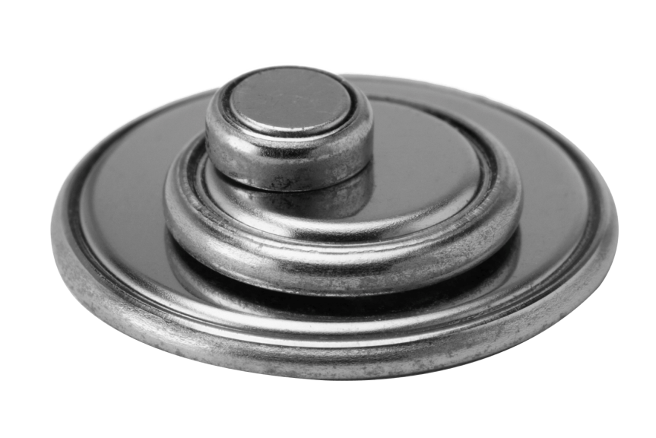
!
!
Do not touch leaking or damaged batteries with your bare hand. Use gloves and place it in a zip-lock bag for recycling

Slide 20
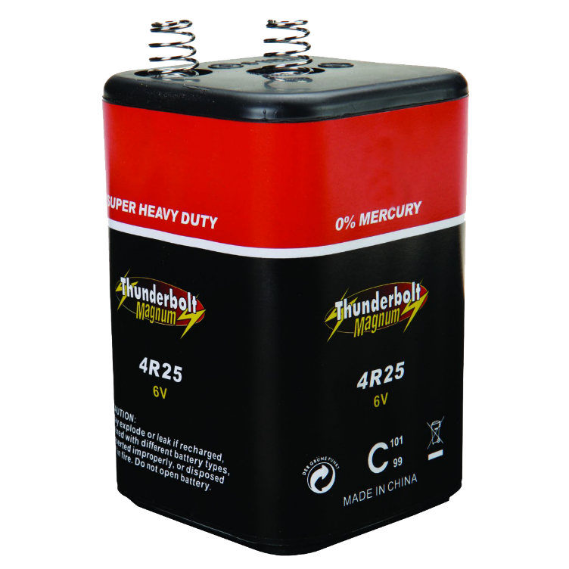
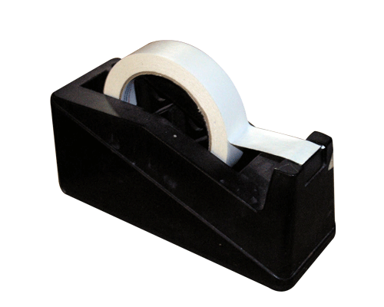
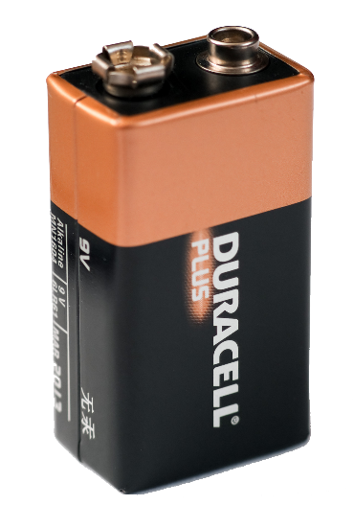
Taping the terminal ends

Slide 21
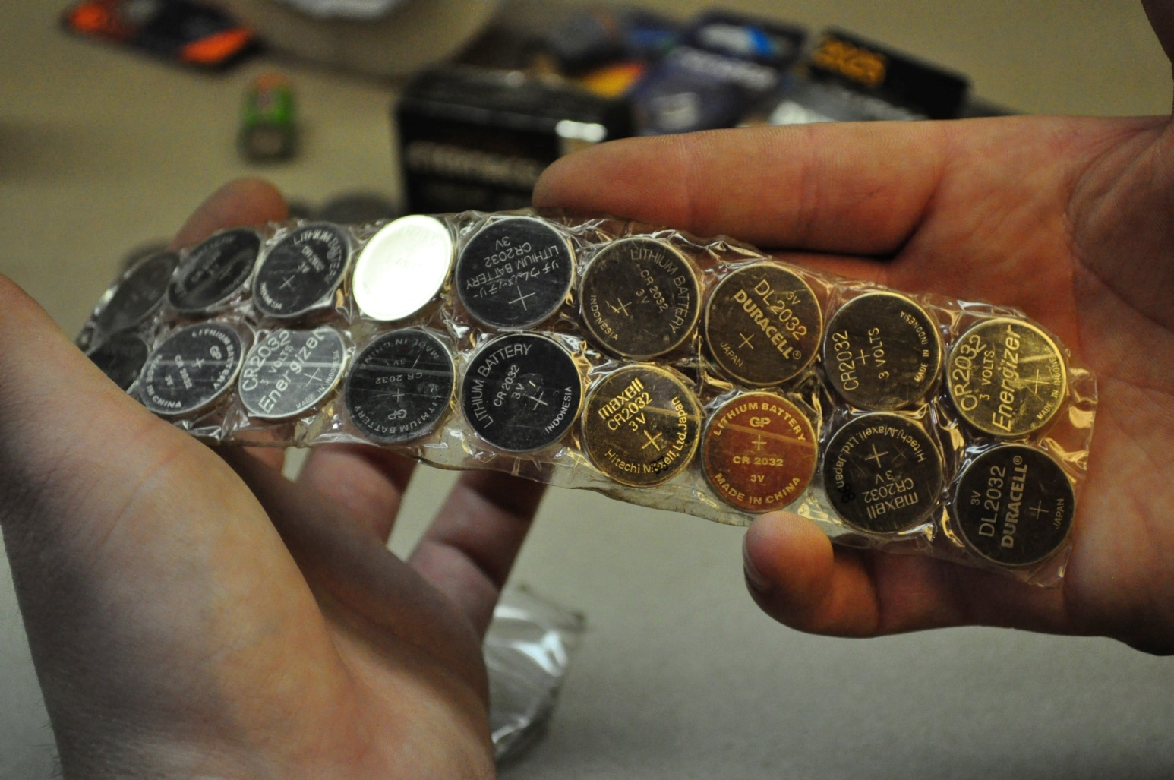
Button cell batteries
Tape both positive and negative terminals on any button cell batteries

Slide 22
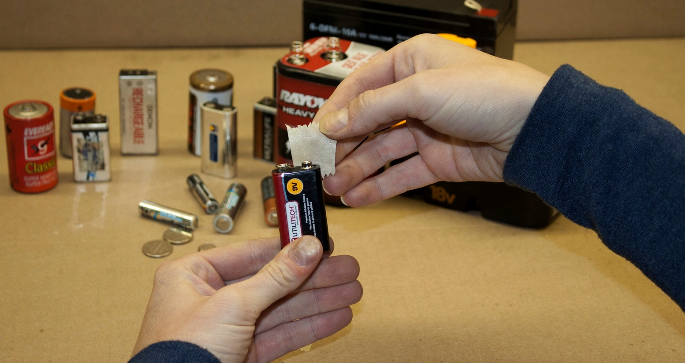
All 9 Volt batteries
9 volt batteries come in a variety of chemistries. Each should have its positive an negative terminals taped

Slide 23
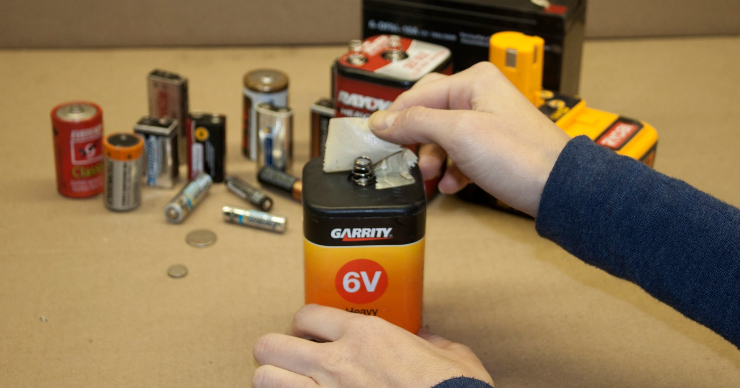
6 Volt
6 volt batteries are used in larger flashlights and lanterns

Slide 24
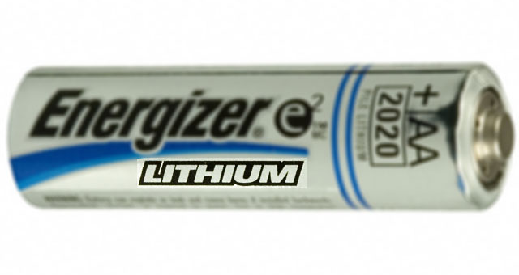
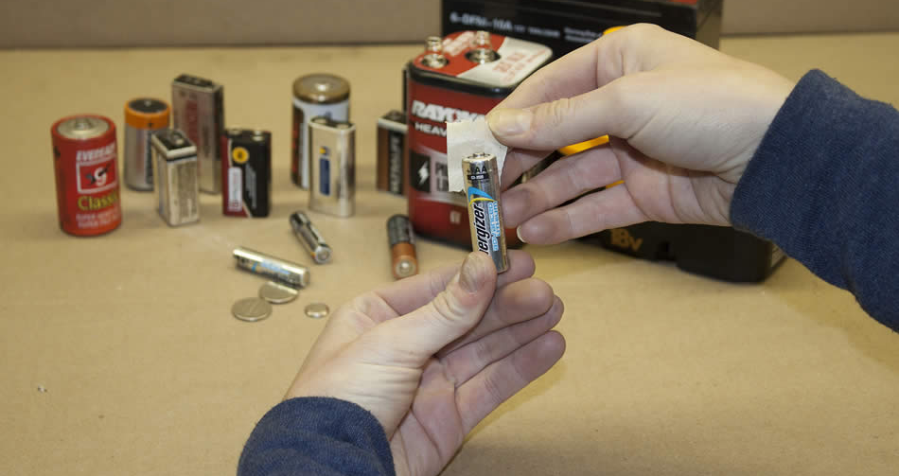
lithium
Primary Lithium batteries come in all sizes, including AAA, AA, C, D & 9 volt

Slide 25
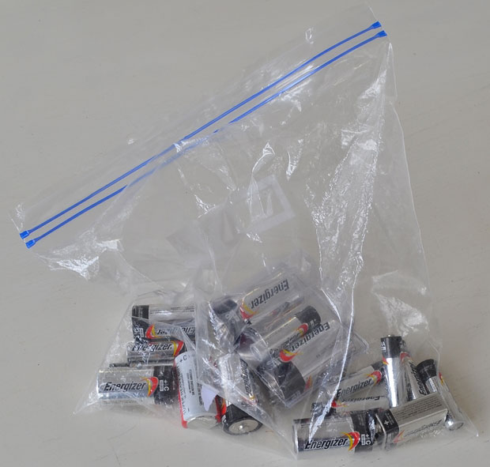

Slide 26
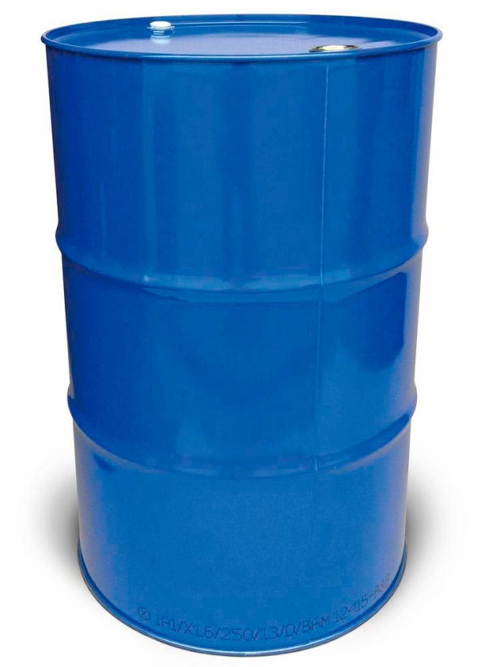
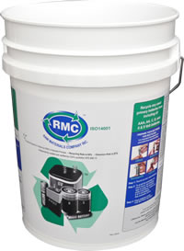
ONTARIO SCHOOLS BATTERY RECYCLING CHALLENGE
www.rawmaterials.com/ontario-school-recycling-challenge/

Slide 28
www.rawmaterials.com

